Slide 1

Searching drug safety data with Boolean searching
Retrieving data from the PharmaPendium drug safety data module
Marnix Wieffer
Senior marketing manager drug safety
Notes:
Hello everybody and welcome to this tutorial video, where I will show you how you can retrieve critical drug safety data with PharmaPendium with Boolean searching

Slide 2
Learning objective
Why working with Boolean operators?
Drug safety module
Multiparametric search example
At the end of this video you should have good understanding how to retrieve drug safety data from PharmaPendium using Boolean operators.
This should enable your to quickly uncover critical safety insights, supporting animal model selection and identify translational risk.
New to drug safety searching in PharmaPendium?
Suggested watch: Introduction to retrieving drug safety data
Notes:
During this training session we will learn how we can benefit from working with Boolean operators during drug safety searching, work with the drug safety module and learn how to search over multiple parameters in a live training example.
At the end of this…..
If you are new to searching drug safety information in PharmaPendium I would suggest to watch the video : Introduction to retrieving drug safety data first.
In that introduction video we looked for single adverse events in a single species, Wy would be looking for multiple affects and/or species at the same time?

Slide 3

Why include multiple adverse events and/or species in a drug safety search?
Optimize your preclinical/clinical design to mitigate risk of serious adverse events
Quickly retrieve a list of relevant drugs based on your advanced search criteria, thus helping you mitigate the risk of missing critical information
Quickly understand if the co-occurrence of adverse events is a significant concern by looking at precedent drug information
Learn from drugs that have an adverse events profile similar to yours.

Slide 4
Example question:
  I am developing a new antineoplastic drug and observe changes in red blood cell numbers and cardiac arrhythmias in rat.
  What currently marketed antineoplastic drugs showed a similar adverse event profile in both rat and human?
  Impact: Animal model selection, Translational insights
Notes:
For the live training, let’s work with the following example questions

Slide 5
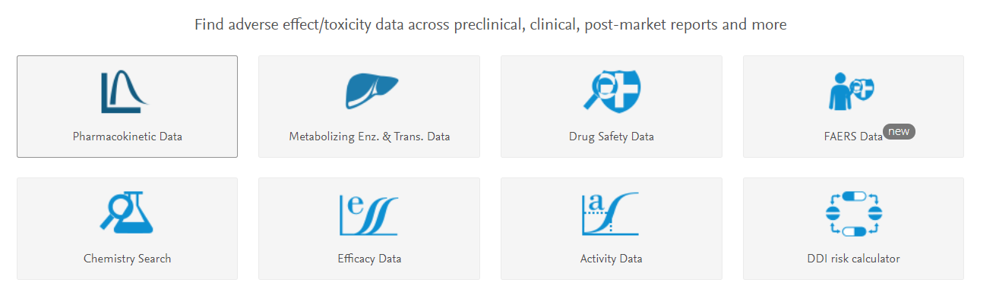
Search in Drug Safety data

Slide 6
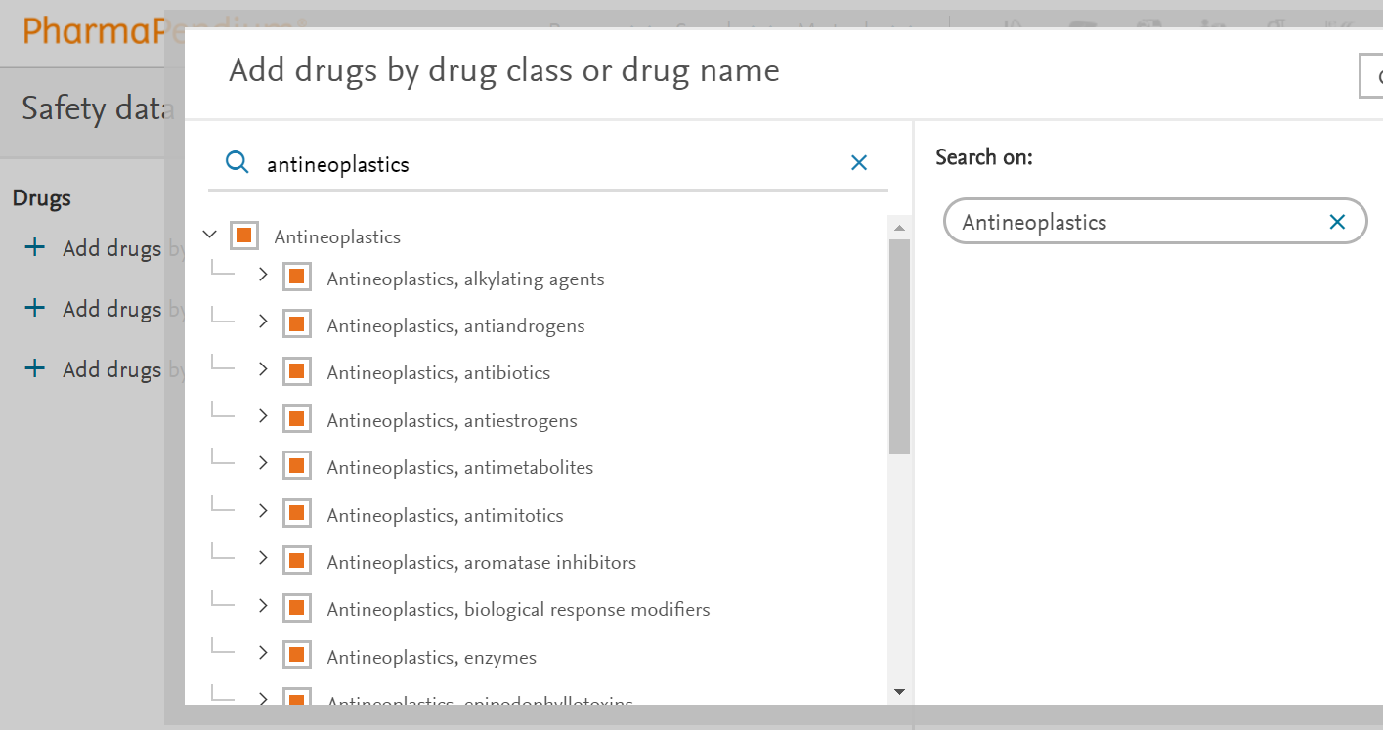
Add drug class of interest

Slide 7
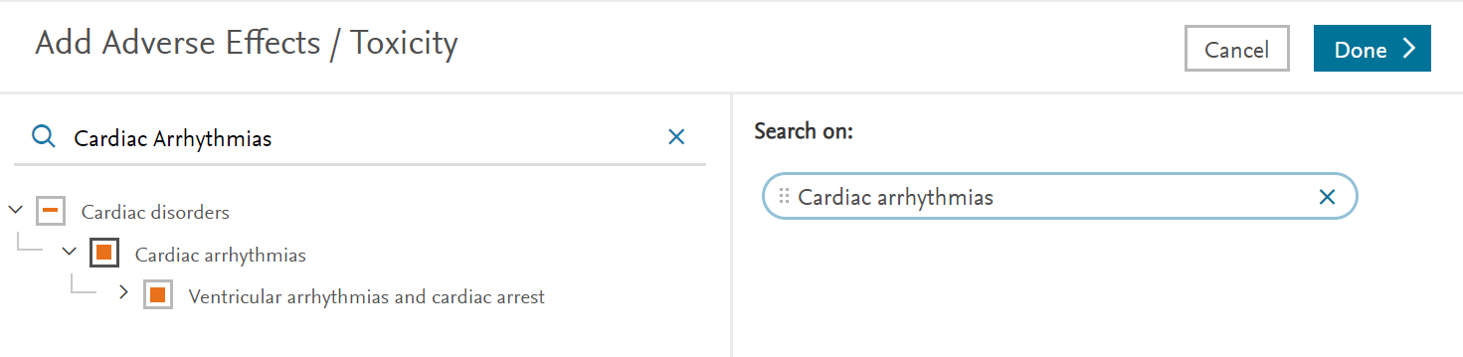
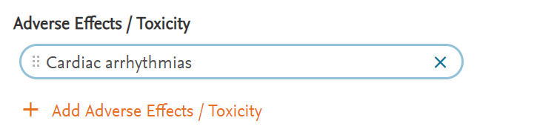
Add Adverse effects of interest
2) Done
1) Add adverse event #1
3) Add adverse effect/toxicity

Slide 8
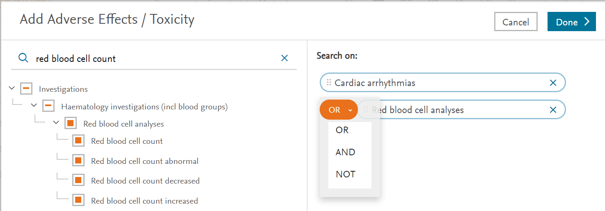
Add Adverse effect of interest
6) Done
4) Add adverse event #2
5) Change operator to and

Slide 9
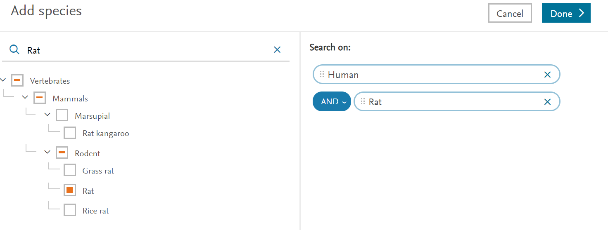
Add species of interest

Slide 10
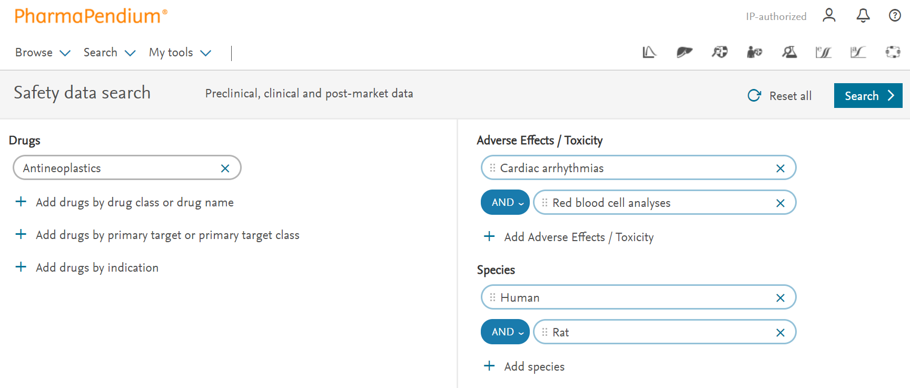
The query
Notes:
One strengths of PharmaPendium are the many expert taxonomies it is using, allowing us to together a complex query in just a few click. If we are happy with this query, we click on searh

Slide 11
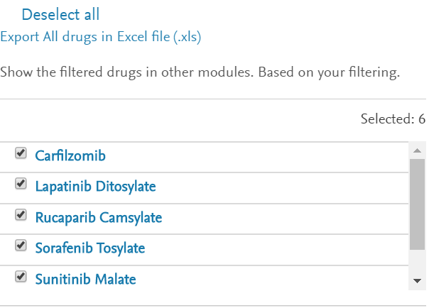
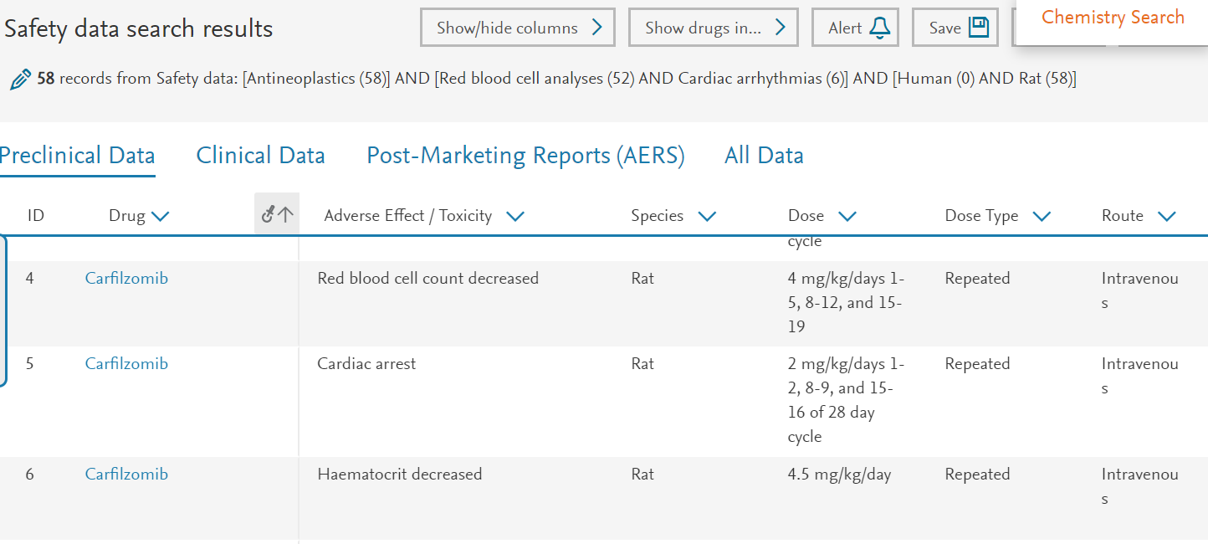
Result
6 antineoplastic drugs that have “Blood cell changes” as well as “Cardiac arrythmias” both in rat as well as in the clinic studies
Notes:
What we get are 58 preclinical data lines, and 122 clinical datalines. If we take a look at the preclinical data on we can see that these are on antineoplastic drug for which there is both cardiac arrhythmias as well as blood cell changes. For example for the antineoplastic Carfilzomib we can see both red blood cell count decrease as well as cardiac arrest in Rat.
If we look at clinical data you can see that there were also Arrhytmias and Red blood cell count decreased observed.
Now, our original question was “What currently marketed antineoplastic drugs showed a similar adverse event profile in both rat and human?”. We can now scroll to the data an look at the drug being mentioned in the drug column. Or we can select “show drugs in”, which will show us all the drug represented in this dataset. These are the 6 antineoplastic drugs where cardiac arrhythmias and changes in blood cell count were observed in rat and human.
These are the drug you would like to further investigate. Maybe you would like to know what class of antineoplastic these drugs belong to

Slide 12
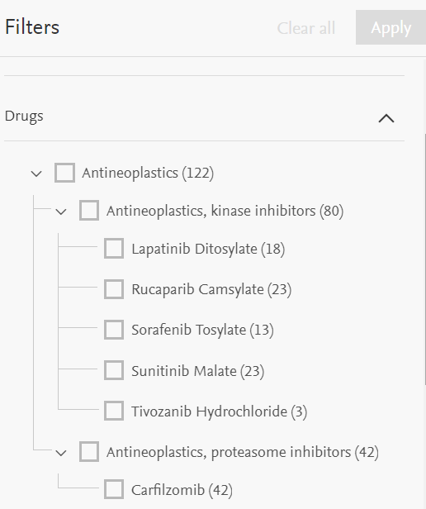
Kinase inhibitors are overrepresented
Notes:
You can open up the filters, open drugs, where we can see that 5 of these drugs are kinas inhibitors. So if I ma developing kinase inhibitor, there might be a high risk of both these effects translating into the clinic.

Slide 13
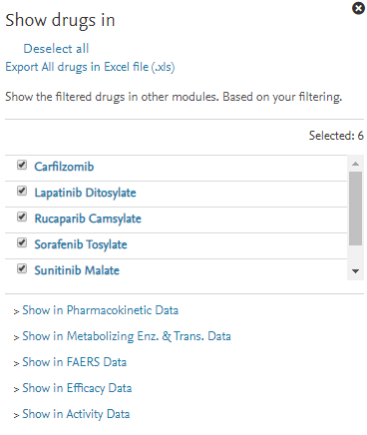
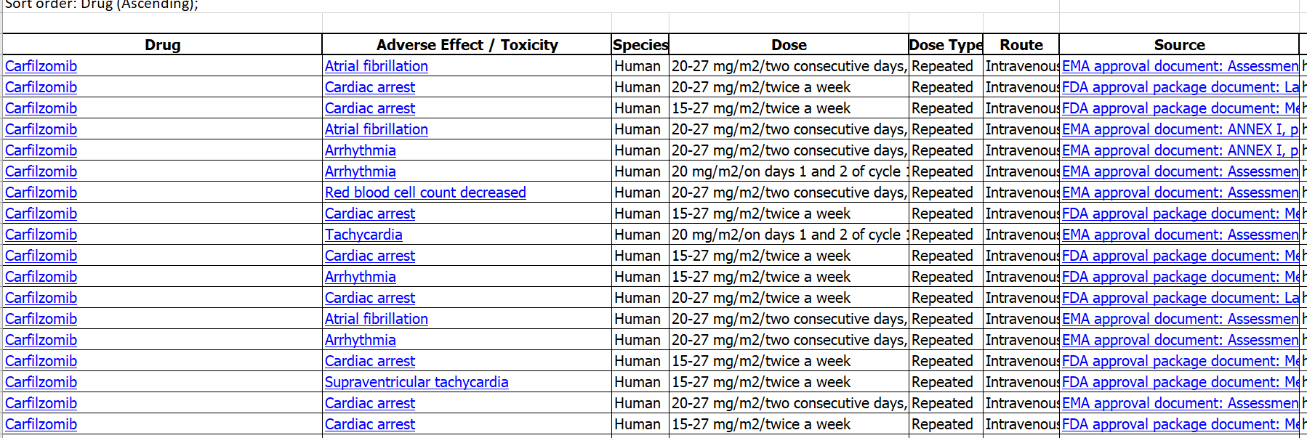
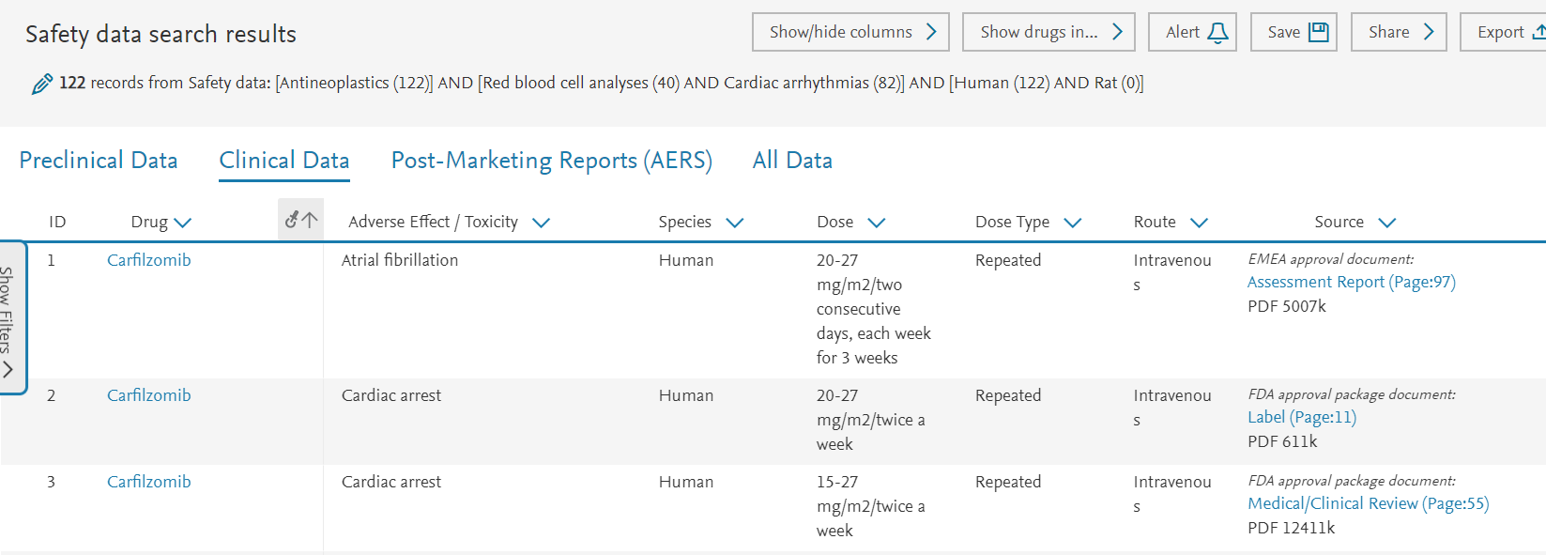
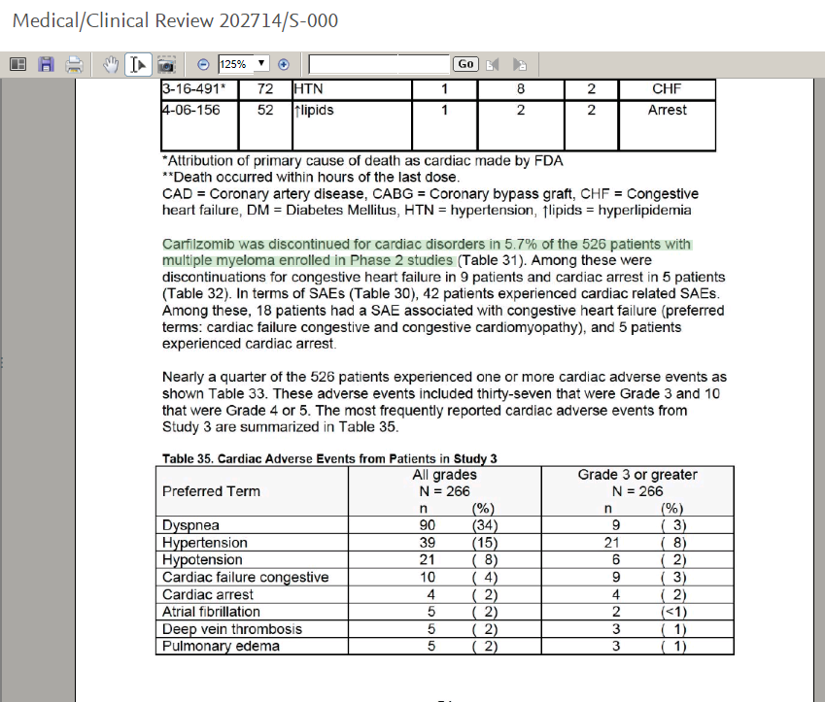
Possible next steps
Show other data
Export
Dive into the full text
Notes:
In case I am developing a kinase inhibitor, this is of course critical information
Last, we can dive into the full text regulatory documents from where the data was extracted and read about the context and reviewer feedback. for example, let’s click onm this medical clinical review
This is critical information if you are developing a related drug , helping you to anticipate safety concerns early

Slide 14
Notes:
With that, I hope I have provided sufficient information for you to get started using Boolean operators in drug safety data searching, ulocking those critical insights In case of any quetsions, please do not hesitate to get in touch. Thank you and bye bye

